Slide 1







CFD ANALYSES OF THE INTERNAL BLOCKAGE IN THE NACIE-UP FUEL PIN BUNDLE SIMULATOR
I. Di Piazza (ENEA), R. Marinari, N. Forgione (UNIPI), F. Magugliani (ANN)
W. Borreani, G. Lomonaco (Uni Genoa), H. Doolaard, F. Roelofs (NRG)
F. Piscaglia, A. Montorfano (PoLiMi), V. Moreau (CRS4)
NURETH-17, 5 September 2017
Xi’an, China
EU Duc = 0E001

Slide 2
Contents
Introduction
BFPS Test Section
CFD Models and Methods
Results
Conclusions and Outlook

Slide 3
Introduction

Slide 4
Introduction
Core cooling needs to be guaranteed under all circumstances
Flow blockage accidents typically lead to degradation of the heat transfer
Numerically this can be analyzed but experimental validation is required
Validation of blockages in liquid metal fuel assemblies employing grid spacers is needed.

Slide 5
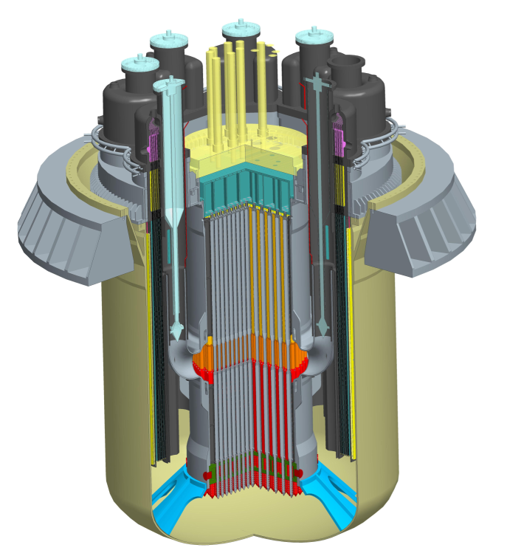
Introduction
ALFRED is under development in Europe as Lead Fast Reactor demonstrator.
ALFRED fuel assembly employs grid spacers
Lead experiment is being prepared at ENEA in Italy
Experiment set-up is preceeded and supported by a broad and shared international numerical modelling effort

Slide 6
BFPS Test Section

Slide 7
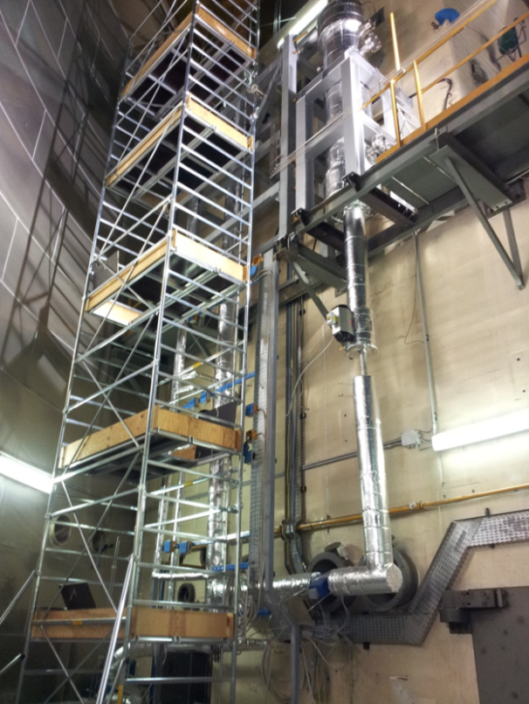
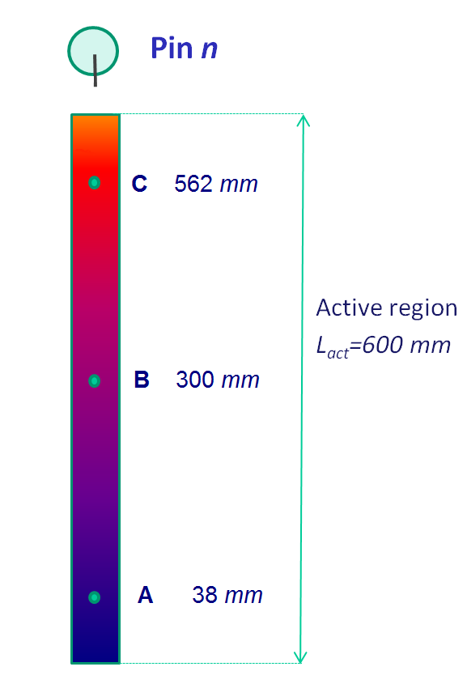
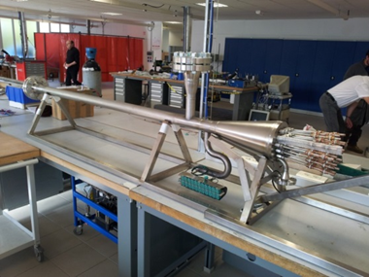
BFPS Test Section
Blockage Fuel Pin Simulator test section in NACIE loop at ENEA in Italy
19-pins
  11 pins instrumented with 52 TCs
  5 sub-channels instrumented with 15 TCs
  600 mm heat length
  D = 10 mm
  P/D =1.4
  250 kW

Slide 8
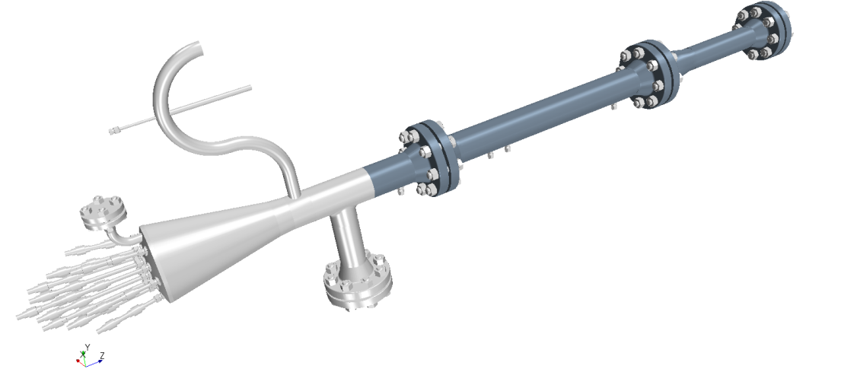
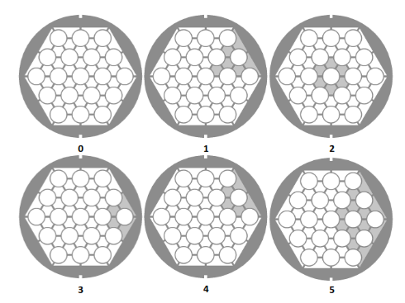
BFPS Test Section
Various blockages
Purposes
  pin wall temperature measurement
  sub-channel temperature measurement
  Heat Transfer Coefficient (HTC) evaluation
  axial temperature profiles
  evaluation of the thermal mixing at the outlet of the pin bundle

Slide 9
CFD Models and Methods

Slide 10

CFD Models and Methods
Boundary conditions (table)
Inlet bend included
Blockage type 4
Constant properties at 220°C from OECD 2007 handbook
Constant properties steel AISI 304
Pr_{t} = 2 to account for liquid metal heat transfer
Boundary | Boundary Condition | Value
Inlet | Mass flow Temperature | 8 kg/s 200°C
Inner pin clad | Heat flux | 156716 W/m²
Walls (fluid-solid) | Velocity | No-slip
Outlet | Relative pressure | 0 bar

Slide 11
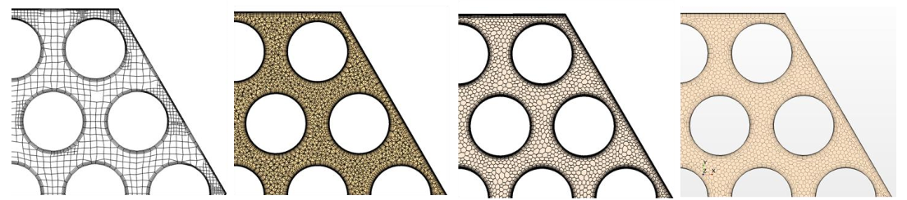
CFD Models and Methods
 | Code | Mesh | Type | Turbulence
PoLiMi | OpenFOAM | 22.3M | Hex | RANS k-ε
ENEA/UniPi | CFX15 | 29.8M | Tet | RANS k-ε
NRG | CCM+ 11.06 | 22.4M | Poly | URANS k-ε
Unige/CRS4 | CCM+ 11.04 | 14.0M | Poly | URANS k-ε Prel. LES WALE

Slide 12
Results

Slide 13
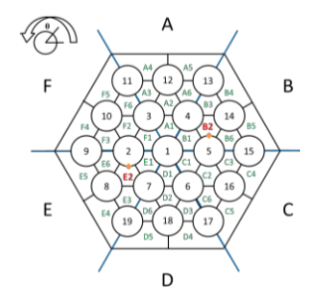
Results
Comparison based on pragmatic ‘engineering’ parameters
  Velocity components and velocity in center of two sub-channels
  Pin clad surface temperature
  Temperature on three axial lines in mixing region
  Temperature on three different radial lines at three different axial locations in the mixing region

Slide 14
Results
Unblocked reference case (sub-channel)
  Temperature predictions within in range of 3°C
  Velocity predictions show similar trends

Slide 15
Results
Unblocked reference case (pin)
  Temperature predictions within in range of 5°C

Slide 16
Results
Blocked case
  Similar location of peak temperature
  RANS and URANS predict higher peak temperatures than LES
  Velocity predictions show similar trends

Slide 17
Results
Blocked case
  Similar location of peak temperature
  RANS and URANS predict higher peak temperatures than LES

Slide 18
Conclusions and Outlook

Slide 19

Conclusions and Outlook
Conclusions
  Even though differences can be identified, independent pre-test simulations show similar general trends for velocity and temperature predictions for blocked and unblocked cases
  Preliminary LES performed but care should be taken in drawing firm conclusions upon it
Outlook
  Comparison of RANS/URANS with improved LES
  Comparison with experimental data

Slide 20
Disclaimer
Goods labeled with an EU DuC (European Dual-use Codification) not equal to ‘N’ are subject to European and national export authorization when exported from the EU and may be subject to national export authorization when exported to another EU country as well. Even without an EU DuC, or with EU DuC ‘N’, authorization may be required due to the final destination and purpose for which the goods are to be used. No rights may be derived from the specified EU DuC or absence of an EU DuC.

